Slide 1


K.RAMAKRISHNAN COLLEGE OF TECHNOLOGY
(AUTONOMOUS), TRICHY
AI-BASED DYNAMIC EMERGENCY RESPONSE ROUTE OPTIMIZATION USING A SEARCH ALGORITHM
PRESENTED BY GUIDED BY
GOWTHAM S - 2403811724321027 Ms. ADEEBA AAISHA F
HARIPRIYA A - 2403811724321031 TA /AIDS
HARSHITA P - 2403811724322032

Slide 2
PRESENTATION OVERVIEW
Abstract
Objective
Architecture diagram
Literature survey
Research methodology
Existing system
Proposed system
Conclusion
Future enhancement

Slide 3
ABSTRACT
This project helps emergency vehicles find the best route quickly.
It can be used for ambulances, police vehicles, and fire engines.
The system uses the A algorithm* to find the shortest and best route.
It considers traffic conditions and blocked roads while selecting the route.
The best route is shown clearly on the map, helping emergency vehicles reach their destination faster.

Slide 4
OBJECTIVE
To find the best route for emergency vehicles.
To reduce the travel time during emergencies.
To consider traffic and blocked roads while finding the route.
To use the A algorithm* for efficient route selection.
To provide a simple map-based system to display the selected emergency route .

Slide 5
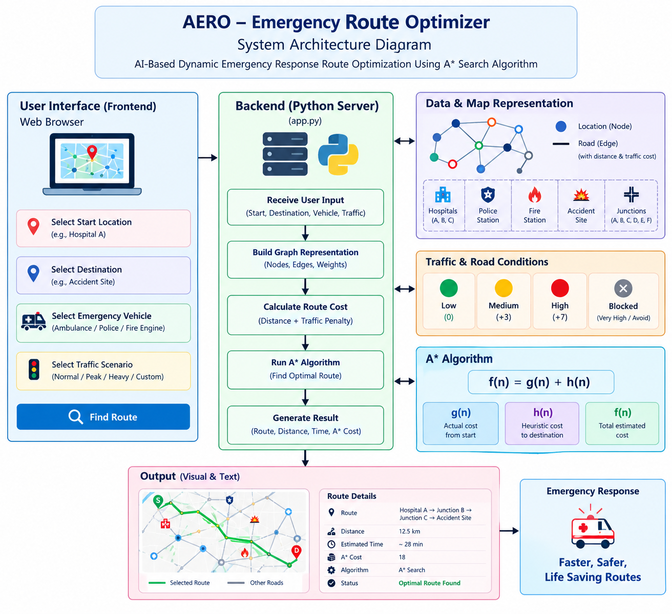
ARCHITECTURE DIAGRAM

Slide 6
LITERATURE SURVEY
Ai-based Dynamic Emergency Response Route Optimization Using A Search Algorithm

Slide 7
RESEARCH METHODOLOGY
Collect Data – Collect road and traffic information.
Create Graph – Represent locations and roads as nodes and edges.
Apply A* – Find the best route using the A* algorithm.
Test Routes – Test with different traffic and road conditions.
Analyze Results – Check the route, distance, and travel time.

Slide 8
EXISTING SYSTEM
Uses normal GPS/navigation systems for route finding.
Mainly focuses on shortest or fastest route.
May not consider emergency vehicle priority.
Traffic and road conditions may not be handled specifically for emergencies.
Blocked roads can cause delays in emergency situations.

Slide 9
PROPOSED SYSTEM
Uses A* algorithm to find the best route.
Considers traffic conditions while selecting the route.
Avoids blocked and high-traffic roads.
Supports ambulance, police, and fire vehicles.
Provides a faster and safer emergency route.

Slide 10
CONCLUSION
AERO finds the best route for emergency vehicles.
It uses the A* algorithm for route optimization.
It considers traffic and blocked roads.
It helps reduce travel time and delays.
The system provides a faster and safer emergency response.
Notes:
10

Slide 11
FUTURE ENHANCEMENT
Add real-time traffic data.
Add GPS live tracking.
Use Google Maps/OpenStreetMap integration.
Add AI-based traffic prediction.
Add automatic accident detection and alerts.

Slide 12
THANK YOU

